Slide 1
3D Game programming
Project 3D Game Development
Developer: n.van.der.heide@pl.hanze.nl

Slide 2
3D Game programming
Plan
This week’s challenge
Working with Unity

Slide 3
Assignment a challenge with 4 steps
Introduce
Deconstruct
Reconstruct
Expand

Slide 4
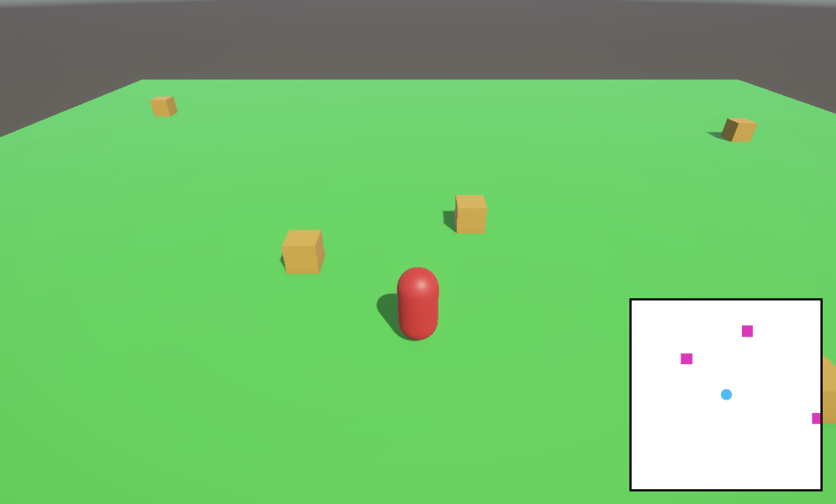
Step 1: Introduce introduction of the problem and demonstration of the end result
Create a scene with a plane, a player capsule and a few boxes. The scene should have a mini map that shows icons where the player and the boxes are (meaning it doesn’t show the actual capsule and cubes).

Slide 5
Step 1: Introduce a few things to point you in the right direction
Almost no coding in this example
Only 4 lines of code used for moving the capsule. The rest is solved by using features within the Unity engine.

Slide 6
Step 1: Introduce a few things to point you in the right direction
Render texture
You can render what a camera sees to a texture. You can then apply this texture to other objects.

Slide 7
Step 1: Introduce a few things to point you in the right direction
Raw Image
If you want to display a texture on a UI image element, make sure to use Raw Image instead of Image.

Slide 8
Step 1: Introduce a few things to point you in the right direction
The mini map icons
The mini map icons are sprites (squares and circles). To use 2D sprites in a 3D project you will need to install the Unity 2D packages from the package manager.

Slide 9
Step 2: Deconstruct deconstruct the problem into small sub-problems
“Create a scene with a plane, a player capsule and a few boxes. The scene should have a mini map that shows icons where the player and the boxes are (meaning it doesn’t show the actual capsule and cubes).”
Break the main problem down into smaller problems for you to solve.
Write these small sub-problems in a list.
Make sure to think about a logical order.
At the end of each step you have a functioning product that has part of the functionality implemented.
At the end of the last step you have a functioning product that solves the main problem.

Slide 10
Step 3: Reconstruct reconstruct the solution by solving the sub-problems
“Create a scene with a plane, a player capsule and a few boxes. The scene should have a mini map that shows icons where the player and the boxes are (meaning it doesn’t show the actual capsule and cubes).”
Solve the sub-problems from the list one at a time.
After solving a sub-problem you should have a working (read: error free) product with part of the functionality implemented.
Make sure to continue with the next sub-problem only when you finished the current one.
After solving the last sub-problem you should have reconstructed the solution shown in step one and you have solved the main problem.

Slide 11
Step 4: Expand how can you expand on this project?
Write down three ways in which you could expand on this project
Write down three ways how you could use the knowledge gained from this project in another project

Slide 12
Assignment working with Unity
Work on artifacts for your portfolio.
For example:
Expand on today’s challenge.
Use the knowledge from today’s challenge in a different context.
Work on your own project.
Work on features for the group project.

Slide 13
Homework what to work on before next week
Work on artifacts for your portfolio.
For example:
Expand on today’s challenge.
Use the knowledge from today’s challenge in a different context.
Work on your own project.
Work on features for the group project.

